Slide 1
Digital Image Processing
Lecture - 3
Autumn 2009

Slide 2

Image Formation Model

Slide 3
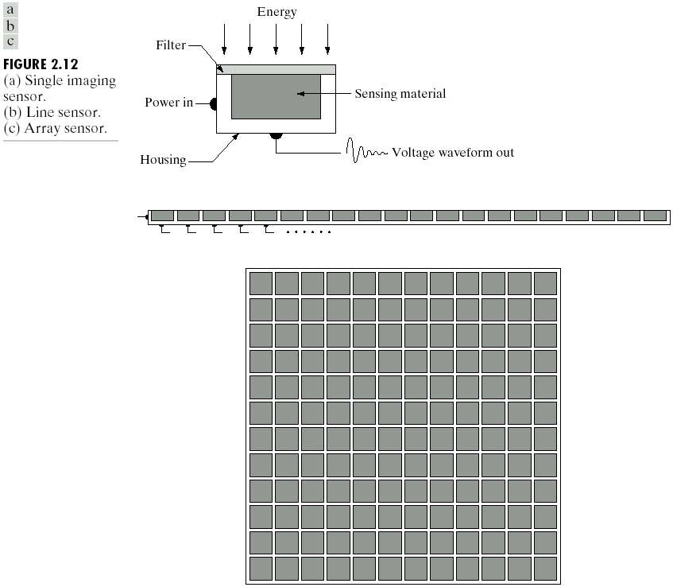
CCD Unit

Slide 4
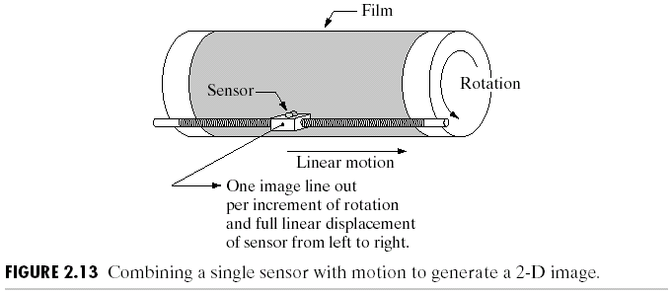
Image Generation by Single Sensor

Slide 5
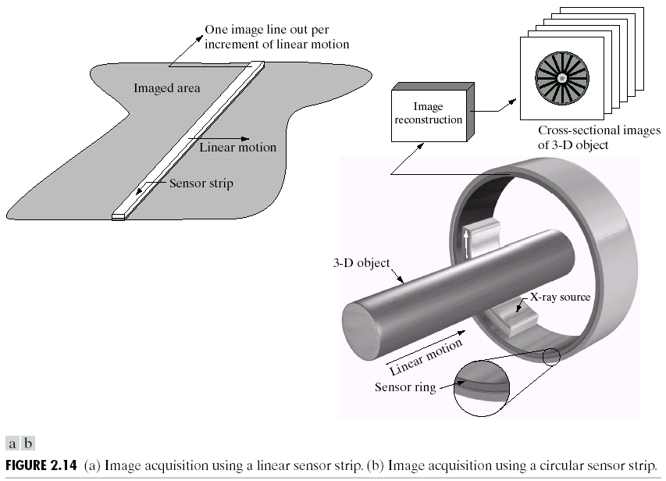
Image Generation by Line Sensor

Slide 6
Image Generation by Array Sensor

Slide 7

Digitization of Image: Sampling & Quantization

Slide 8

Digitized Image

Slide 9
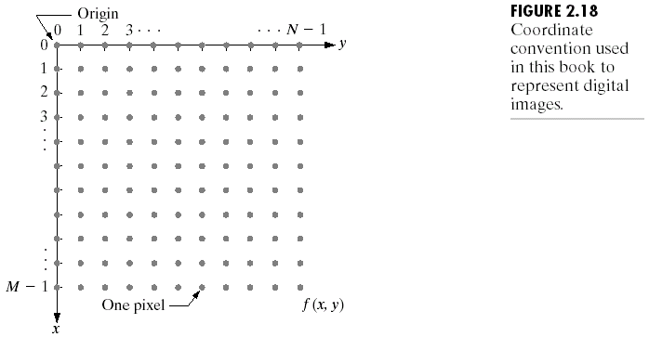
Representation of Digital Image

Slide 10
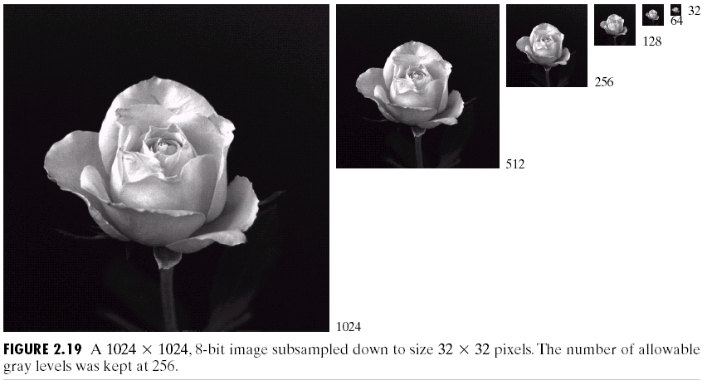
Spatial Resolution

Slide 11

Grayscale Resolution (1/2)

Slide 12

Grayscale Resolution (2/2)

Slide 13
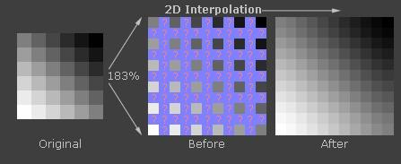
Image Zooming
http://www.cambridgeincolour.com/tutorials/image-interpolation.htm

Slide 14
Image Zooming Approaches
Pixel Replication.
Nearest Neighbor.
Bilinear Interpolation.
…

Slide 15
Image Zooming Approaches in MATLAB
Nearest Neighbor.
Bilinear Interpolation.
Bicubic Interpolation.

Slide 16
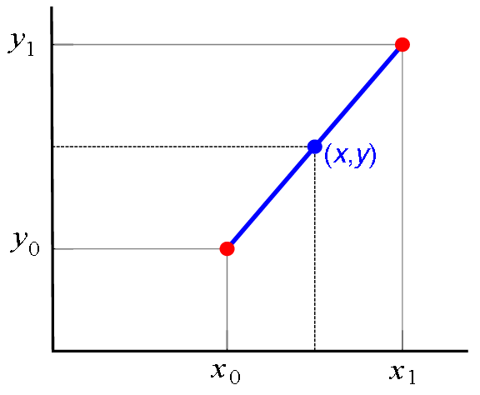
Linear Interpolation
http://en.wikipedia.org/wiki/Linear_interpolation

Slide 17
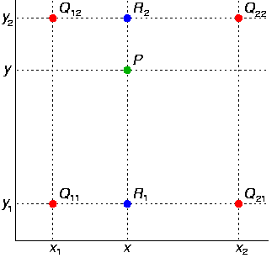
Bilinear Interpolation
http://en.wikipedia.org/wiki/Bilinear_interpolation

Slide 18
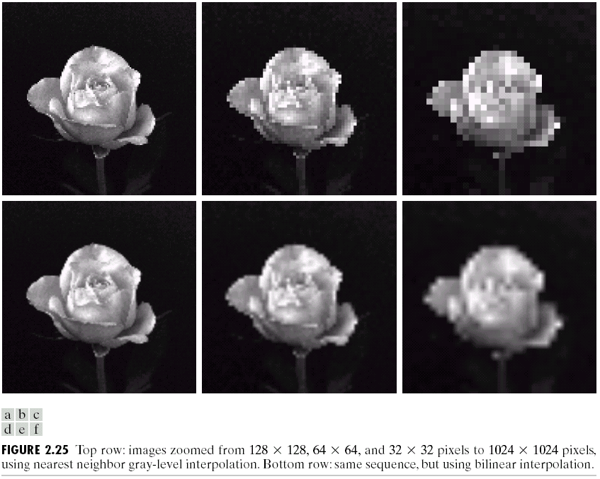
Image Zooming: Increasing Spatial Resolution

Slide 19
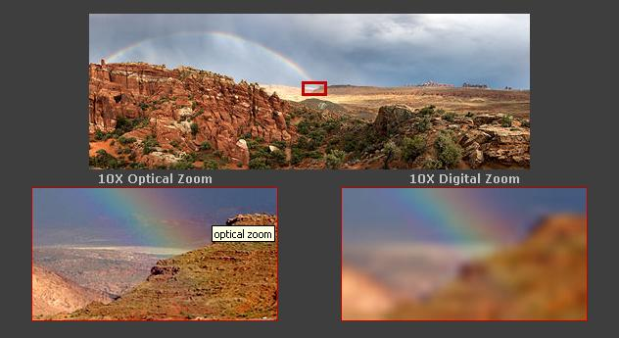
Image Zooming: Optical vs. Digital
http://www.cambridgeincolour.com/tutorials/image-interpolation.htm

Slide 20
Relationship b/w Pixels
4-Neighbors.
8-Neighbors.
4-Adjacency.
8-Adjacency.
Object Labeling.

Slide 21
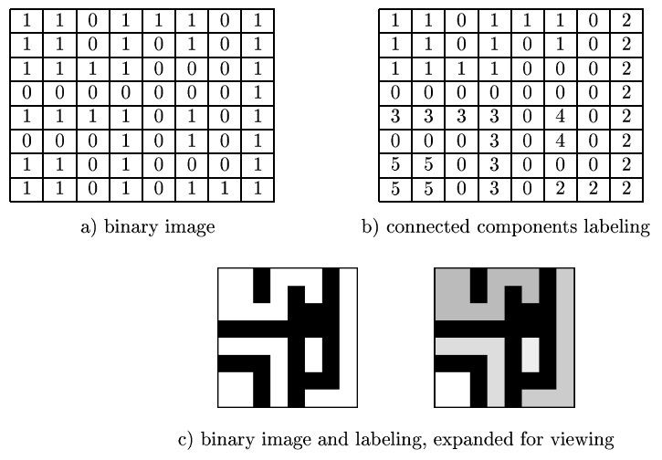
Object Labeling

Slide 22
Assignment # 1
Due Date: Oct 16 Submit to: Ms Afshan
Implement Bi-linear interpolation in OpenCV 3 Marks
Study research papers provided for interpolation. Select any method and prepare 3-5 minutes presentation to be delivered at the end of next lecture
6 Marks
Involvement in all presentations
1 Mark

